Slide 1
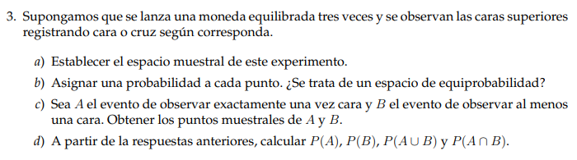



















$$a)$$
$$1°Lanzamiento$$
$$2°Lanzamiento$$
$$3°Lanzamiento$$
$$C$$
$$C$$
$$X$$
$$C$$
$$C$$
$$X$$
$$X$$
$$C$$
$$C$$
$$X$$
$$X$$
$$C$$
$$X$$
$$X$$
$$S=\left\{\left(C;C;C\right);\left(C;C;X\right);\left(C;X;C\right);\left(C;X;X\right);\left(X;C;C\right);\left(X;C;X\right);\left(X;X;C\right);\left(X;X;X\right)\right\}$$

Slide 2
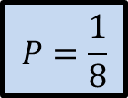

$$b)$$
$$S=\left\{\left(C;C;C\right);\left(C;C;X\right);\left(C;X;C\right);\left(C;X;X\right);\left(X;C;C\right);\left(X;C;X\right);\left(X;X;C\right);\left(X;X;X\right)\right\}$$
$$Son 8 resultados posibles y equiprobables$$
$$P=\frac{1}{8}$$
$$"probabilidad de cada uno de los resultados posibles"$$

Slide 3

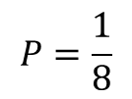

$$c)$$
$$S=\left\{\left(C;C;C\right);\left(C;C;X\right);\left(C;X;C\right);\left(C;X;X\right);\left(X;C;C\right);\left(X;C;X\right);\left(X;X;C\right);\left(X;X;X\right)\right\}$$
$$P=\frac{1}{8}$$
$$"probabilidad de cada uno de los resultados posibles"$$
$$A=\left\{\left(C;X;X\right);\left(X;C;X\right);\left(X;X;C\right)\right\}$$
$$B=\left\{\left(C;C;C\right);\left(C;C;X\right);\left(C;X;C\right);\left(C;X;X\right);\left(X;C;C\right);\left(X;C;X\right);\left(X;X;C\right) \right\}$$

Slide 4

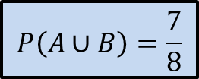
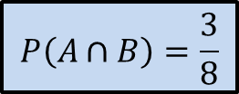
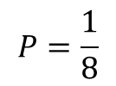
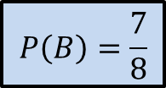

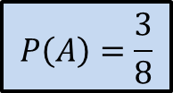

$$d)$$
$$S=\left\{\left(C;C;C\right);\left(C;C;X\right);\left(C;X;C\right);\left(C;X;X\right);\left(X;C;C\right);\left(X;C;X\right);\left(X;X;C\right);\left(X;X;X\right)\right\}$$
$$P=\frac{1}{8}$$
$$"probabilidad de cada uno de los resultados posibles"$$
$$A=\left\{\left(C;X;X\right);\left(X;C;X\right);\left(X;X;C\right)\right\}$$
$$B=\left\{\left(C;C;C\right);\left(C;C;X\right);\left(C;X;C\right);\left(C;X;X\right);\left(X;C;C\right);\left(X;C;X\right);\left(X;X;C\right) \right\}$$
$$P\left(A\right)=\frac{3}{8}$$
$$P\left(A∩B\right)=\frac{3}{8}$$
$$Obs:$$
$$P\left(B\right)=\frac{7}{8}$$
$$P\left(A∪B\right)=\frac{7}{8}$$

